Slide 1
Project Work :
UE15CS490(Major)/UE15CS492(Minor)
Final ISA(Review 5) / ESA 2019
Project Title : Performance Comparison of Machine Learning Techniques used for Music Genre Classification
Project ID : PW19RBA01
Project Guide : Prof. Raghu B.A. Rao
Project Team : Sandeep K Mysore(01FB15ECS262)

Slide 2
Problem Statement
Music Genre Classification is being used in multiple Music Streaming websites and applications to provide the users with means to understand more about the characteristics of the music they are listening to and to provide genre wise categorical recommendations.
Yet, this is a very daunting task in the Music Information Retrieval (MIR) domain.

Slide 3
This project demonstrates the performance, in terms of classification accuracy, of various Machine Learning and Deep Learning Algorithms for the purpose of classifying music based on genre.
K-Nearest Neighbors (KNN), Logistic Regression, Support Vector Machine (SVM) are the Machine Learning algorithms being compared in this project along with Convolutional Neural Network (CNN) which is a Deep Learning algorithm.

Slide 4
The algorithms are also trained on the features extracted from the GTZAN dataset which consists of audio clips for 9 different genres.
The feature extraction methods used in this project are Fast-Fourier Transforms (FFT) and Mel-Frequency Cepstral Coefficients (MFCC).

Slide 5
Literature Survey
The Various papers for the literature survey are:
[1] Sturm, Bob L, “An analysis of the GTZAN Music Genre Dataset”
[2] Thierry Bertin-Mahieux, Daniel P.W. Ellis, Brian Whitman, Paul Lamere, “Million Song Dataset”, 12th International Society for Music Information Retrieval Conference (ISMIR 2011)

Slide 6
[3] G. Jawaherlalnehru, S. Jothilakshmi, “Music Genre Classification using Deep Neural Networks”, © 2018 IJSRSET | Volume 4 | Issue 4 | Print ISSN: 2395-1990 | Online ISSN : 2394-4099
[4] Alif Noushad, Albin Paul, Anjana Mukesh, Ebin B Plackal, Mohan T D and Anjali S, “A Study on Different Music Genre Classification Methods”, International Journal of Computer Science and Mobile Applications, Vol.6 Issue. 2, February- 2018, pg. 131-138
[5] Y.M.D. Chathuranga, K.L. Jayaratne,“Automatic Music Genre Classification of Audio Signals with Machine Learning Approaches”, GSTF International Journal on Computing (JoC), Vol. 3 No.2, July 2013

Slide 7
Proposed Solution
The proposed approach is to analyze the audio signals of the GTZAN dataset, which is in .au format, convert it to a more suitable .wav format and extract features from it.
For feature extraction we have used Fast Fourier Transforms (FFT) and Mel Frequency Cepstral Coefficients (MFCC) mainly because FFT has been around for some time and MFCC is a more modern method.

Slide 8
This provides a contrast, in development of algorithms with respect to time.
The ML algorithms chosen for classification are CNN, KNN and SVM. CNN, a deep learning algorithm is also implemented for this purpose. The outcome will be classification accuracies of each of the feature-model pairs.

Slide 9
Why Your Solution is Better?
The features of the solution are:
Dataset – GTZAN
Feature Extraction using MFCC
Training the model using KNN, SVM, LR and CNN

Slide 10
Technologies / Methodologies
The Software Technologies used in this project are:
Python
Version: 2.7
Source: https://www.python.org/
Pycharm IDE
Description: Python IDE for professional developers
Version: 3
Source: https://www.jetbrains.com/pycharm/

Slide 11
Packages | Version
Tensorflow | 1.13.1
Keras | 2.2.4
Numpy | 1.16.2
Pip | 19.0.3
Conda | 4.6.14
Python-speech-features | 0.6
Scikit-learn | 0.20.3
Scipy | 1.2.1
Sox | 1.3.7
Librosa | 0.6.3

Slide 12
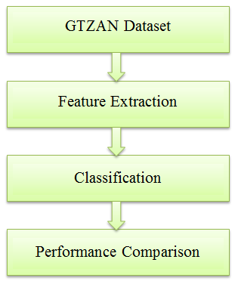
System Architecture

Slide 13
Modules
The Modules are:
1. Data Preprocessing
2. Feature Extraction
3. Classification
4. GUI

Slide 14
Design Approach
Choice of Dataset
GTZAN dataset was finally decided upon.
This dataset was chosen because of the format of the dataset (.au format). This was inline with the proposed approach.

Slide 15
Data Preprocessing Methods
SoX or Sound eXchange was the final approach used for data pre-processing.
It was chosen as it is a very powerful cross-platform package/ utility that can handle multiple audio formats
It is rightly called the “The Swiss Army Knife” of sound processing programs.

Slide 16
Choice of method for Feature Extraction
The feature extraction method finally used were both FFT and MFCC
MFCC was chosen as it is a modernized and improvised feature extraction method which keeps FFT as part of the process.
The other reason was to provide a contrast between a modern and an older feature extraction method.

Slide 17
Method of Implementing CNN
The final approach to implementing CNN was to use the VGG-16 Architecture.
This consists of 16 Layers in total. A combination of 4 Layers in is run sequentially 4 times. The layers consist of Conv2D layer applied twice, followed by a MaxPooling2D layer to reduce spatial dimensions followed by a dropout layer.

Slide 18
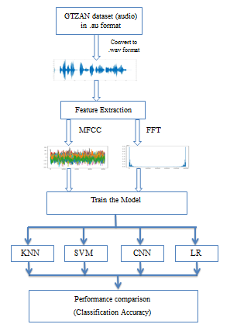
Implementation Details

Slide 19
Project Completion
Project Report Status – Ready
Project Demo – Partially done

Slide 20
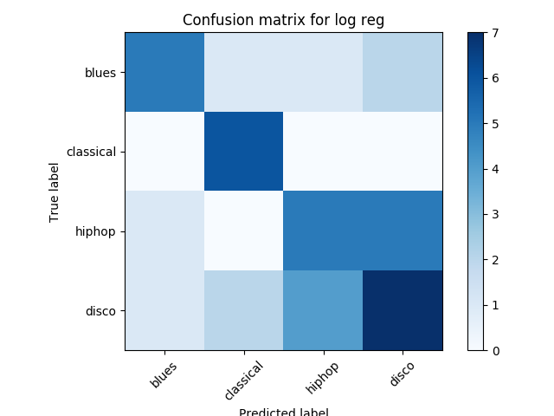
Project Results
FFT-Logistic Regression pair :

Slide 21
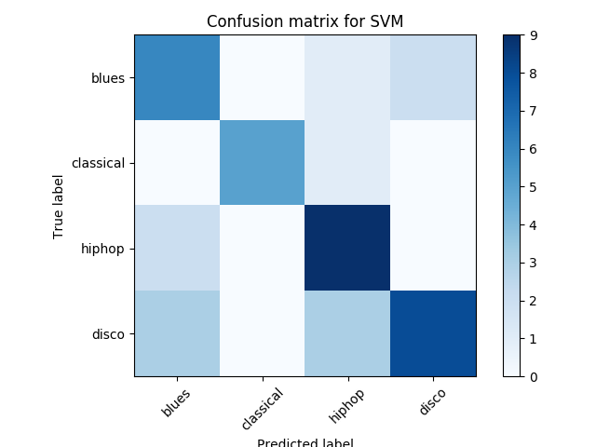

Slide 22
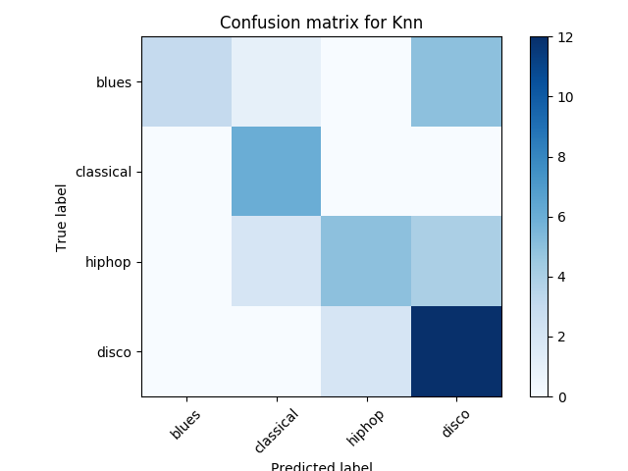

Slide 23
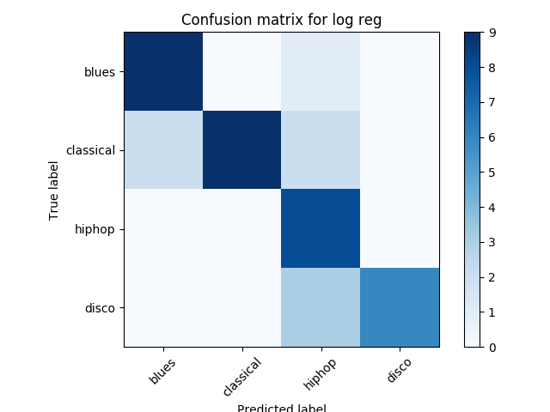

Slide 24
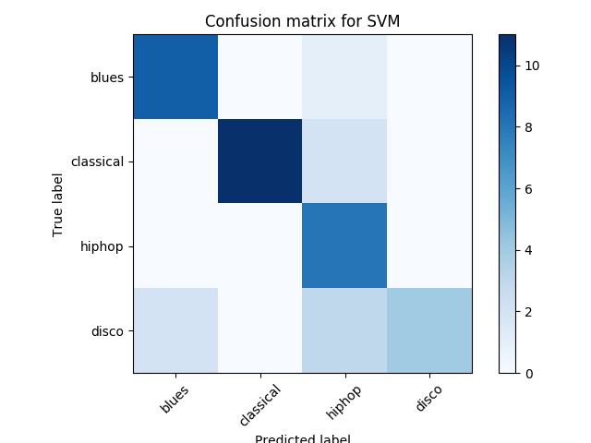

Slide 25
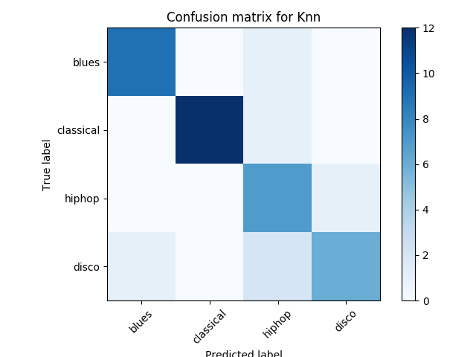

Slide 26
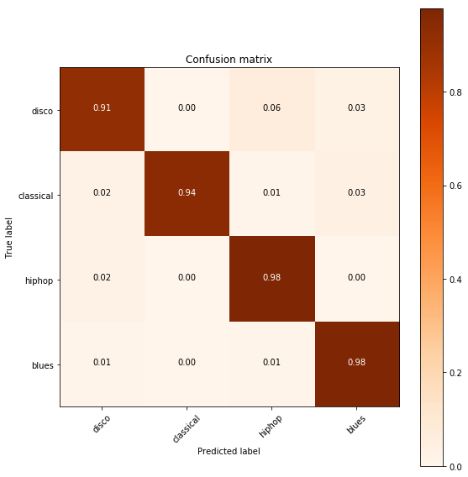

Slide 27
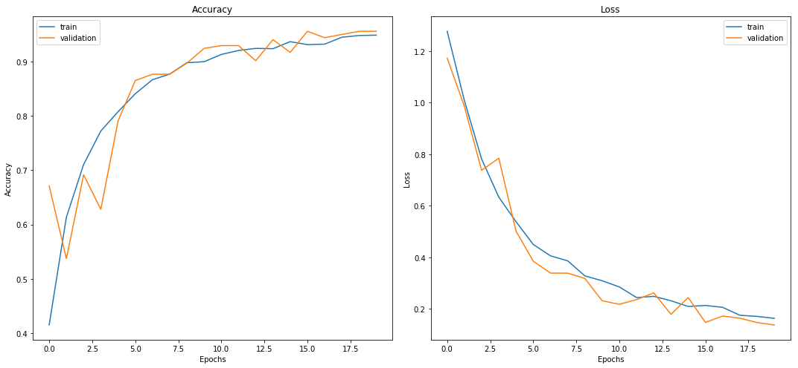

Slide 28
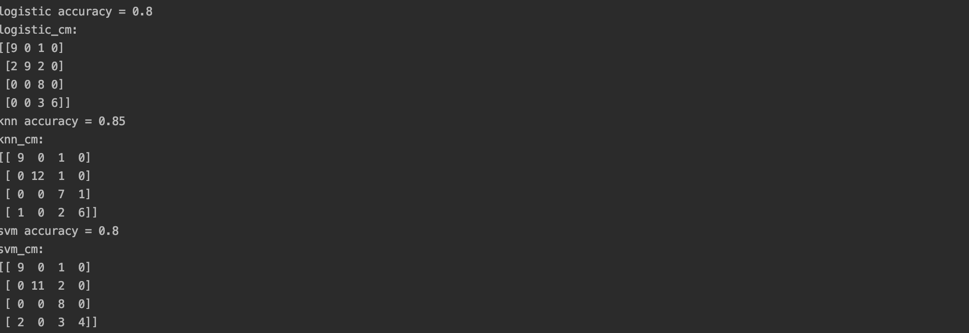
MFCC Result

Slide 29
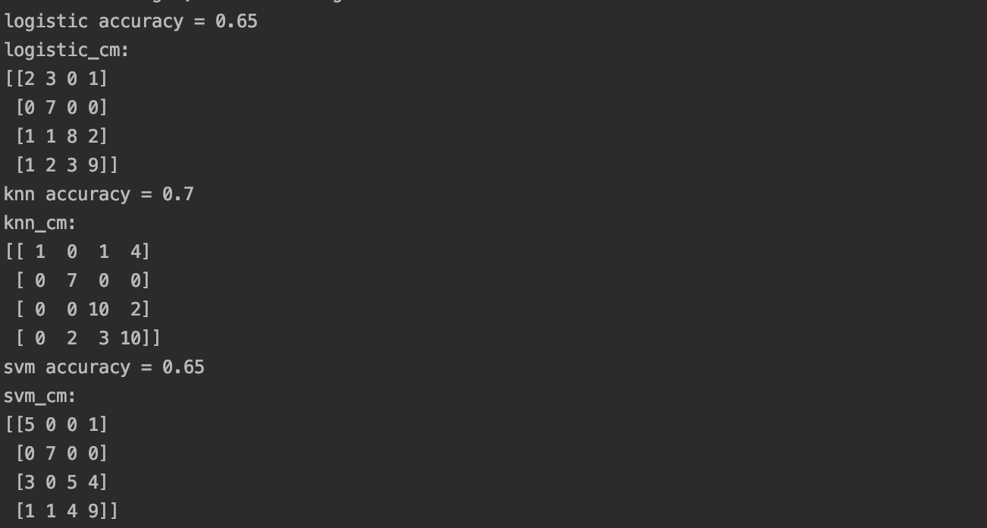
FFT Result:

Slide 30
Thank You

